Slide 1
Errors and Exceptions

Slide 2
Learning Objective:
In this lesson, you will learn error and exception handling in Python.
By the end of the lesson, learners will be able to:
Describe the meaning of Programming Errors and Exceptions.
Handle exceptions using the try, except, and finally statements.
Raise an exception.
Use built-in exception effectively to build robust Python programs.
_____________________________________________________
Python - Errors and Exception Handling

Slide 3
Table of Contents
Why Errors Exist
Overview of Errors and Exceptions
Programming Errors
Built-in Exceptions
The “try” and “except” Blocks to Handling Exceptions
Syntax for try and except
The Else Clause
The Finally Clause
Raising an Exception
The AssertionError Exception

Slide 4
Why Errors Exist
Problem
So far, we have presumed that the users will input exactly what we intend for them to input. We also presumed that our code will only be used according to our expectation. As you can imagine, these presumptions are unrealistic.
Solution
In order to deal with "something going wrong," Python uses Errors and Exceptions. Accounting for these Exceptions is a huge part of programming.

Slide 5
Overview of Errors and Exceptions
An Exception is an event or abnormal condition that occurs during the execution of programs or may happen at runtime, disrupting the normal flow of execution.
We can handle exceptions to ensure our code gets executed normally. On the other hand, an Error is an action that is incorrect or inaccurate.
Errors indicate that something severe has gone wrong; as such, the application should crash rather than try to handle the error. Errors are usually beyond the control of the programmer; therefore, programmers should not try to handle errors.

Slide 6
Overview of Errors and Exceptions (continued)
There are at least two distinguishable kinds of Errors: Syntax Errors/Parsing Errors and Exceptions, which you should be familiar with, and should be paying attention to when writing code. We can categorize Exceptions into two categories: Runtime Errors and Logic Errors:
Syntax Errors / Parsing Errors:
Errors in the formatting or layout of code that are detected by the interpreter.
Runtime Errors / Exception:
Errors in the code that are only apparent when the code runs, causing the program to abort. Runtime errors include things such as dividing by zero, using an undefined variable name, or accessing an object attribute that does not exist.
Logic Errors / Exception:
Errors in the logic of code that causes the program to produce an incorrect result.

Slide 7
Example: Syntax Error / Parsing Error
Error caused by not following the proper structure (syntax) of the language is called syntax error or parsing error.
if a < 3
#File "<stdin>", line 1 if a < 3
^
#SyntaxError: invalid syntax
(We can notice here that a colon is missing in the if statement.)

Slide 8
Example: Exceptions
While a statement or expression might be syntactically accurate, it can still trigger an error upon execution. These errors, identified during runtime, are referred to as exceptions. They arise in situations such as attempting to open a nonexistent file (FileNotFoundError), dividing a number by zero (ZeroDivisionError), or failing to find the specified module during import (ImportError).
Whenever a runtime error occurs, Python creates an exception object. If not handled properly (most exceptions are not handled by default), it prints a traceback to that error, along with some details about why that error occurred.
>>> 1 / 0
#Traceback (most recent call last):
#File "<stdin>", line 1, in <module>
#ZeroDivisionError: division by zero
>>> open("imaginary.txt")
#Traceback (most recent call last):
#File "<stdin>", line 1, in <module>
#FileNotFoundError: [Errno 2] No such file or directory: 'imaginary.txt'

Slide 9
Built-In Exceptions
Python comes with various built-in exceptions, as well as with the possibility to create user-defined exceptions. The following are the few examples:
ZeroDivisionError - Raised when division or modulo by zero takes place for all numeric types.
EOFError - Raised when there is no input from input() function and the end of file is reached.
ImportError - Raised when an import statement fails.
KeyboardInterrupt - Raised when the user interrupts program execution.
IndexError - Raised when an index is not found in a sequence.
NameError - Raised when an identifier is not found in the local or global namespace.
IOError - Raised when an input/output operation fails.
OSError - Raised for operating system-related errors.
IndentationError - Raised when indentation is not specified properly.
Click here to visit official website for the python built-in exceptions methods.
Click here to visit wiki document for built-in exception example.

Slide 10
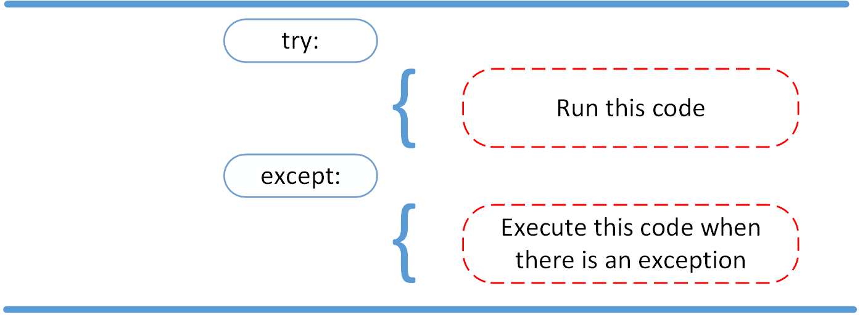
The “try” and “except” Block to Handling Exceptions
The try and except block is used to catch and handle exceptions. Python executes code following the try statement, and if there are any exceptions raised from the code, Python responds with the code that follows the except statement. The code in the try clause will stop executing as soon as an exception is encountered.
Img src:pynative.com

Slide 11
Syntax for “try” and “except” Block
The syntax for try and except is:
try:
Code to be executed
except:
Code to be executed when exceptions raise
When syntactically correct code runs into an error, Python will throw an exception error. This exception error will crash the program if it is unhandled. The except clause determines how the program responds to exceptions.
Remember: We CANNOT have a try block without an except block. Click here for more information.

Slide 12
Guided Lab - Exception Handling - Try and Catch Block
Guided Lab 341.1.1 - The “try” and “except” Block to Handling Exceptions

Slide 13
Example: try and multiple Except Block
You can include numerous “except” blocks in the “try” block. This is beneficial because each “except” block will handle a different type of error.
try:
num1 = input('Enter 1st number: ')
num2 = input('Enter 2nd number: ')
result = (int(num1) * int(num2))/(10 * int(num2))
except ValueError as ve:
print(ve)
exit()
except ZeroDivisionError as zde:
print(zde)
exit()
except TypeError as te:
print(te)
exit()
except:
print('Unexpected Error!')
exit()
print(result)
Output:
Enter 1st number: 10
Enter 2nd number: 0
division by zero
Enter 1st number: One
Enter 2nd number: Ten
invalid literal for int() with base 10: 'One'
Enter 1st number: 20
Enter 2nd number: 10
2.0

Slide 14
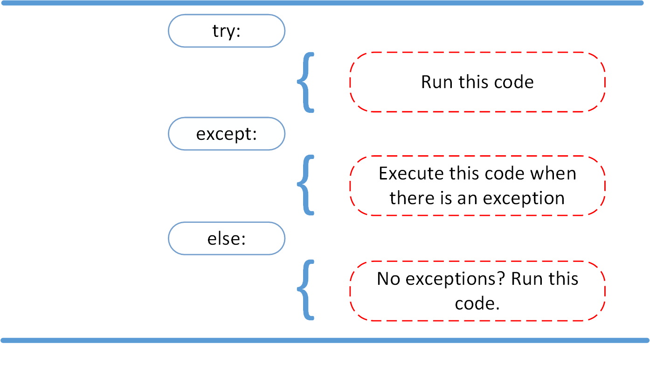
The Else Clause
15
In Python, using the else clause, the program can be instructed to execute a certain block of code only in the absence of any exceptions.

Slide 15
Example: The Else Clause
Note: If, and only if no exception is triggered, the else clause is executed.
def Recp(num):
try:
assert num % 2 == 0
except:
print('Not an even number!')
else:
reciprocal = 1/num
print(reciprocal)
Recp(5)
Recp(10)
Recp(0)
Output
Not an even number!
0.1
Traceback (most recent call last):
File "", line 12, in
File "", line 7, in Recp
ZeroDivisionError: division by zero

Slide 16
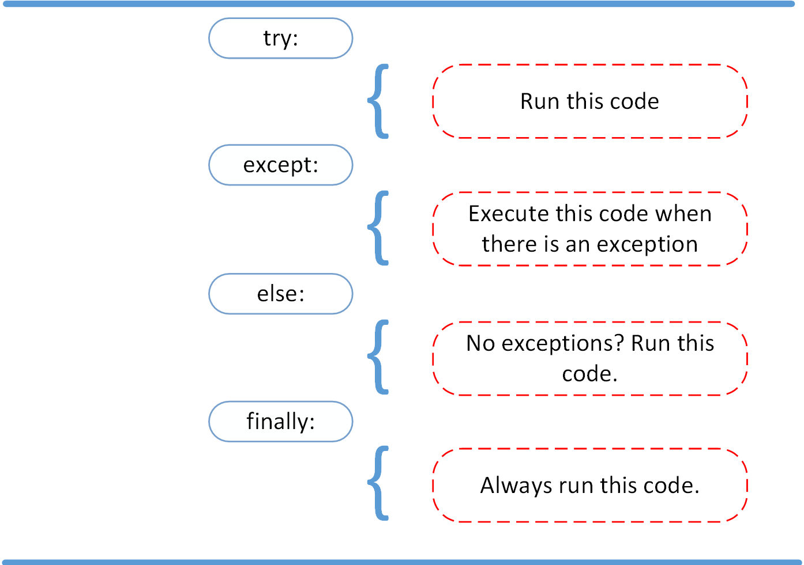
The Finally Clause
The finally block consists of statements, which should be processed regardless of an exception occurring in the try block or not. For instance, when there is some sort of action that needs to be implemented to clean up after executing the code, the finally clause can be used.

Slide 17
Example: The Finally Clause
try:
x,y = 10, 2
z=x/y
except ZeroDivisionError:
print("except ZeroDivisionError block")
print("Division by 0 not accepted")
except:
print('Some error occurred.')
else:
print("Division = ", z)
finally:
print("Executing finally block and This is always executed")
x=0
y=0
print ("Out of try, except, else and finally blocks." )
Output:
Division = 5.0
Executing finally block.
This is always executed out of try, except, else, and finally blocks.

Slide 18
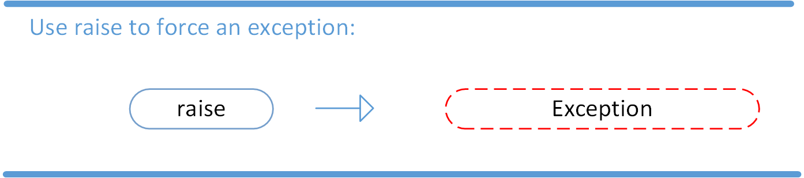
Raising an Exception
The raise clause in Python can be used to forcefully raise an exception if a condition occurs. It comes in handy when we need to throw an exception to stop the application from running. We can optionally pass values to the exception to explain why it was raised.
It is also useful to throw user defined exceptions.
The syntax for using the raise statement is as follows:
raise Exception_class

Slide 19
Example 1: Raising an Exception
Here is an example of using the raise keyword to throw a custom exception.
x = 10
if x > 5:
raise Exception('x should not exceed 5. The value of x was {}'.format(x))
raise Exception('x should not exceed 5. The value of x was {}'.format(x))
Traceback (most recent call last):
File "<stdin>", line 3, in <module>
Exception: x should not exceed 5. The value of x was 10

Slide 20
Example 2: Raising an Exception
try:
num = int(input('Enter a positive integer: '))
if(num <= 0):
# we can pass the message in the raise statement
raise ValueError('That is a negative number!')
except ValueError as e:
print(e)
Output:
Enter a positive integer: -10
That is a negative number!

Slide 21
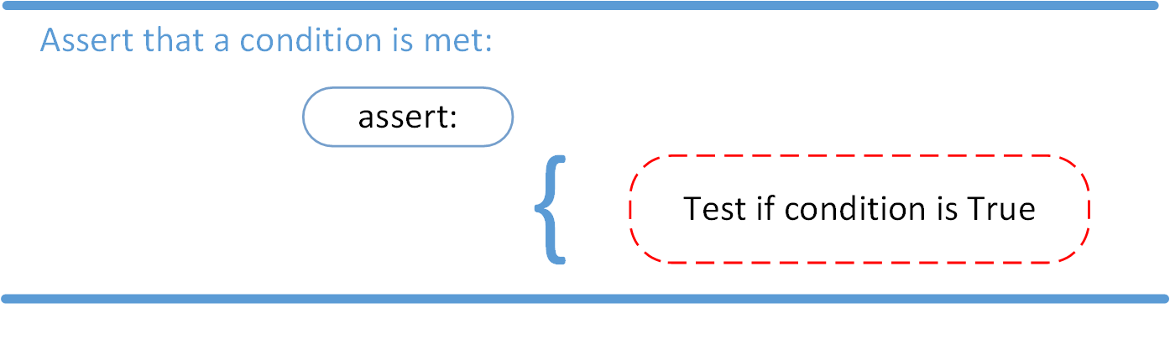
The AssertionError Exception
Instead of waiting for a program to crash midway, we can also start by making an assertion in Python. We assert that a certain condition is met. If this condition is true, then the program can continue. If the condition is false, then the program raises an AssertionError exception.
The syntax for assert is:
assert CONDITION [, ARGUMENT]
If the assertion fails, Python uses ARGUMENT as the argument for the AssertionError.
Notes:
The assert statement works by evaluating a boolean condition and raising an AssertionError if the expression is false. If the specified condition evaluates to True then it continues to execute next statements, otherwise it raises the AssertionError exception with the specified error message.

Slide 22
The AssertionError Exception (continued)
From the example below, the condition is (x <= 5), and the argument is the message. Since the condition is false, the assertion fails and AssertionError exception is raised with the message.
x = 10
assert x <= 5, 'x should not exceed 5. The value of x was {}'.format(x)
Traceback (most recent call last): File "<stdin>", line 2, in <module>
AssertionError: x should not exceed 5. The value of x was 10

Slide 23
Example: Assertion, try, and except Block
The following function, modify_x() function only runs if x is less than equal to 5.
def modify_x():
assert x <= 5, 'x should not exceed 5. The value of x was {}'.format(x)
print('x is being modified')
Let's give the function try.
try:
x = 10
modify_x() except:
pass
🡪 Since x is greater than 5, AssertionError is raised and caught by the except statement and outputs nothing (pass statement).
continue…

Slide 24
Example: Assertion, try, and except Block (continued)
try:
x = 10
modify_x()
except:
print('modify_x() function was not executed successfully')
🡪 Since x is greater than 5, AssertionError is raised and caught by the except statement and prints “modify_x() function was not executed successfully.”
continue…

Slide 25
Example: Assertion, try, and except Block (continued)
In order to see exactly what went wrong, the exact error thrown by the function needs to be caught.
try:
x = 10
modify_x()
except AssertionError as error:
print(error)
print('modify_x() function was not executed successfully')
Since x is greater than 5, an AssertionError is raised and caught by the except statement and prints:
"x should not exceed 5. The value of x was 10' 'modify_x() function was not executed successfully.”

Slide 26
Practice Assignment
Click on the below links:
PA - 341.1.1 Practice Assignment - Python Advanced - Hackerank
In this assignment, you will find several assignments related to basic concepts and advanced concepts. You can use this assignment (challenge problems) throughout Module 341 and Module 342
Note: Use your office hours to complete the assignments. If you have technical questions while performing the practice assignment, ask your instructors for assistance.

Slide 27
Knowledge Check
What are errors in the Python program?
What are logical errors in Python?
In Python, can a try block have multiple excepts?
Can we use a try block without an except block in Python?

Slide 28
Summary
An exception is an event that occurs during the execution of a program and disrupts the normal flow of instructions. Common exceptions include ZeroDivisionError and FileNotFoundError.
Exception handling is the process of dealing with exceptions to prevent program crashes and maintaining graceful program execution. Python provides the try, except, else, and finally blocks for handling exceptions.
The Raise clause allows throwing an exception at any time.
assert enables verification whether or not a certain condition is met, and throws an exception if it is not.
The try clause code is executed until an exception is encountered.
The except clause is used to catch and handle the exception(s) that are encountered in the try clause.
The else clause allows code sections that should run only when no exceptions are encountered in the try clause.
The finally clause enables executing code sections that should run with or without any previously encountered exceptions.

Slide 29
References
https://www.toppr.com/guides/python-guide/tutorials/python-files/python-exception-handling/
https://pynative.com/python-exceptions/

Slide 30

Questions?
18

